Slide 1
Traditional food of Podravina
Food from nature that surrounds us

Slide 2
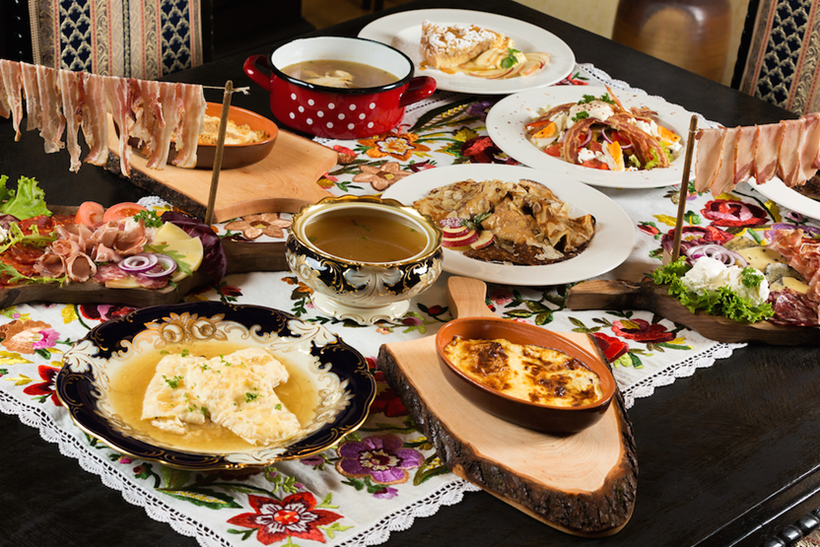
"The inhabitants of the Podravina region are known as Podravci".
Podravci are known for hedonism;
enjoying food and drink.
In our homeland, food is not only a basic need, it is also an invitation to socialize, refreshment from work,
a gift of nature, a source of income,
a folk remedy and much more ...

Slide 3
Almost every household has a garden where vegetables are grown and an orchard where you can pick fruit.
There are many golden fields of wheat, corn and other crops all over Podravina, so dishes based on cereals are very popular.
Many herbs are picked to make herbal teas, and many vineyards are spread on the hills, favourite places to gather and enjoy the nature and food.

Slide 4
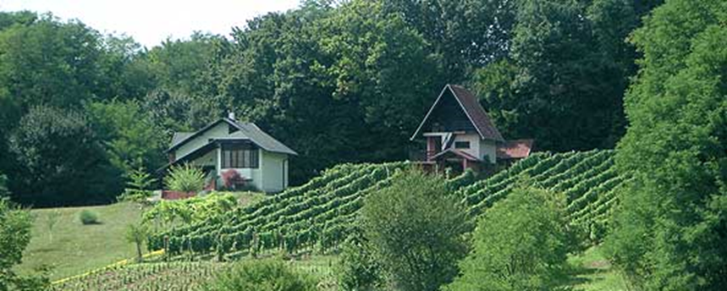
Podravina vineyard

Slide 6
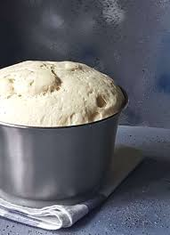
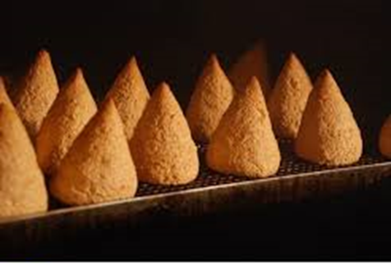
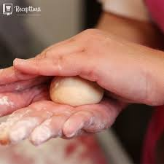
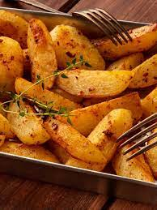
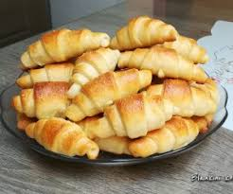
Podravina cuisine is characterized by cow's dairy products, sourdough dishes, meat dishes, vegetable side dishes, cakes and pastry.

Slide 7
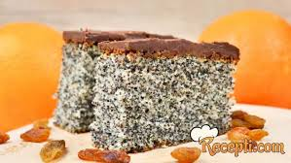
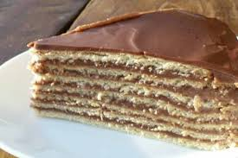
Podravci eat a lot of meat and vegetables but dessert is the course that is unavoidable almost every day.

Slide 8
Podravci breed many animals that they use for food – cows, pigs, poultry, rabbits, wild game ...

Slide 9
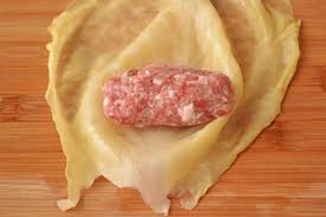
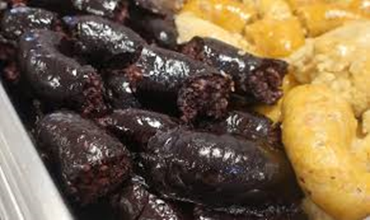
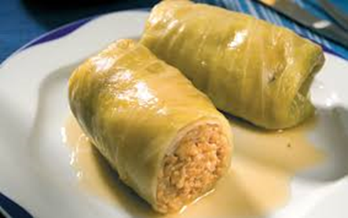
A particular favourite is sarma, a dish of sour kraut and minced meat.
Dishes are prepared with millet, barley and buckwheat porridge.
‘’Krvavice’’ (pork blood sausages; black pudding) and buckwheat porridge are also specialties.

Slide 10
Food that Podravci enjoy almost every day

Slide 11
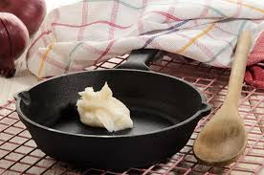
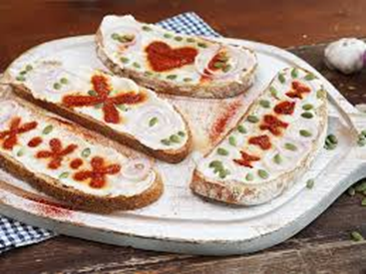
The use of lard used to be common and is today becoming part of the diet again.

Slide 12
Pumpkin seed oil

Slide 13
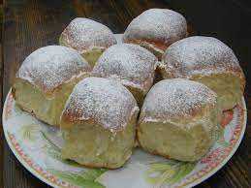
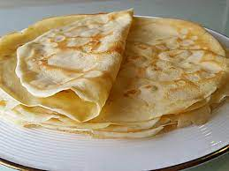
Special attention is paid to desserts, so in Podravina, cakes, pancakes, ‘’zlevanka’’, buns, fingersticks, etc. are made not just for special occasions, but also for ordinary Sunday dinners.

Slide 14
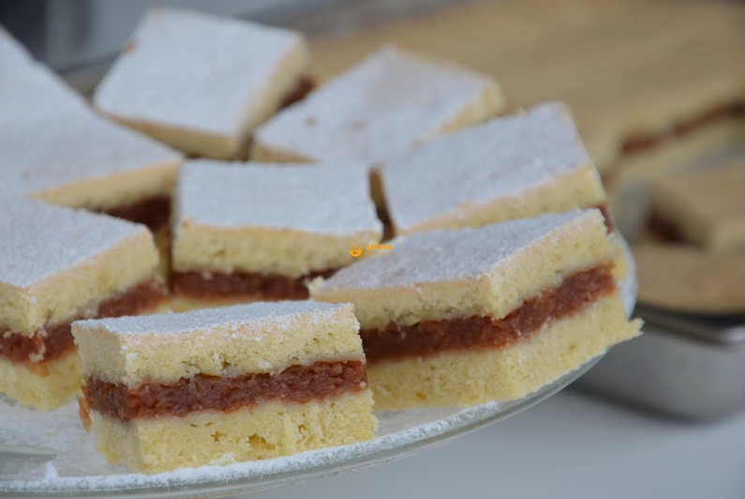
Cakes and pies with walnuts,
poppies, apples…

Slide 15
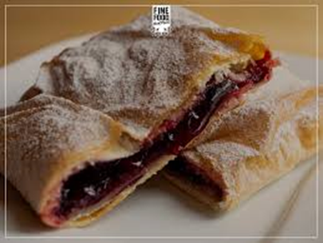
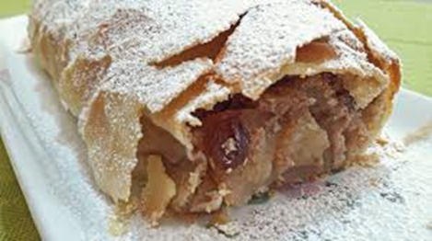
An obligatory dessert are strudels. Strudels can be filled with cheese, apples,cherries, cabbage,buckwheat, pumpkin filling ...

Slide 16
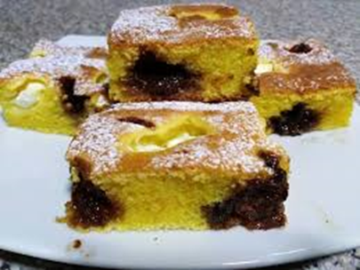
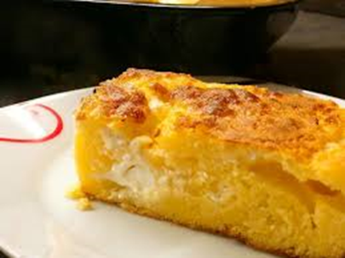
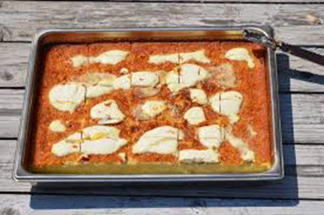
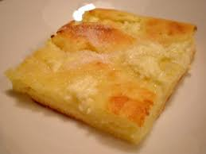
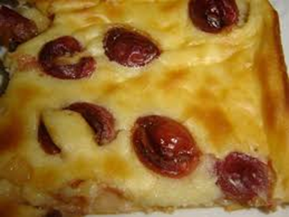
Zlevanka
Zlevanka is made of wheat or corn flour with addition of fruit, homemade jams, sour cream ...

Slide 17
In almost every household in Podravina you will still find homemade preserves, jams and marmalades, homemade elderberry or grape juices ...

Slide 18
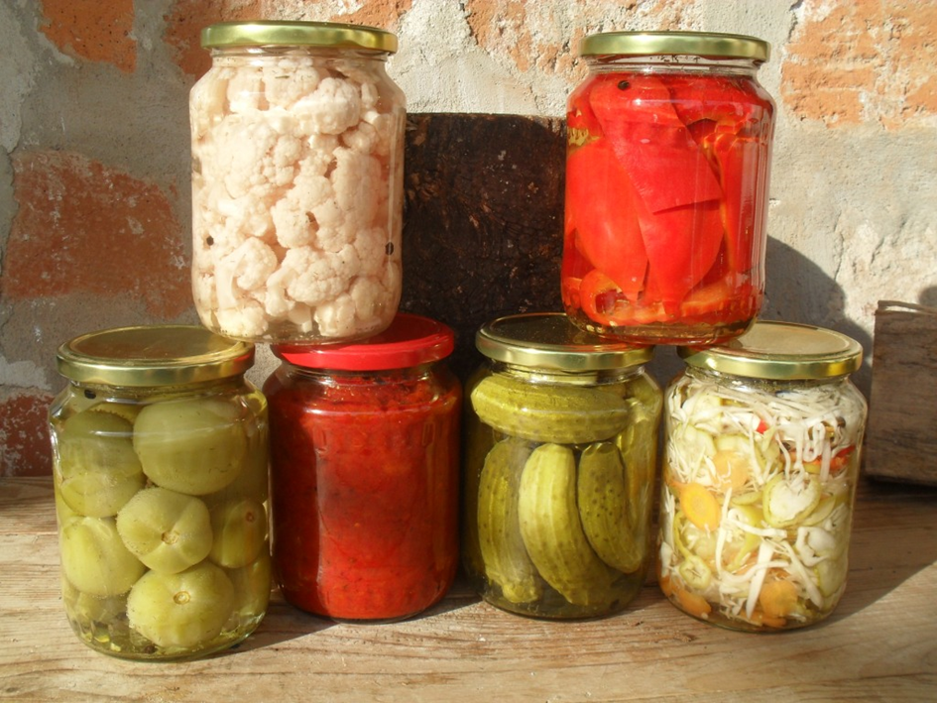
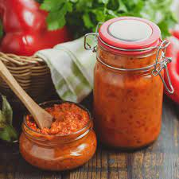
The specialty is ‘’ajvar’’, a spread or a type of chutney made with roasted paprika meat.

Slide 19
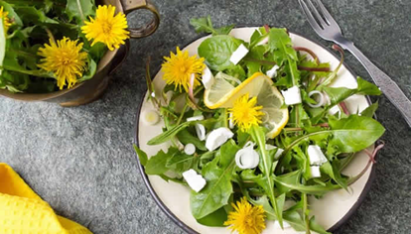
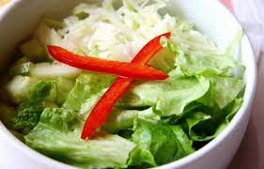
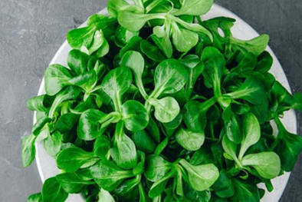
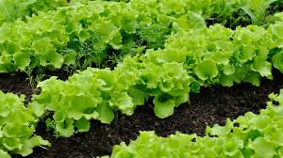
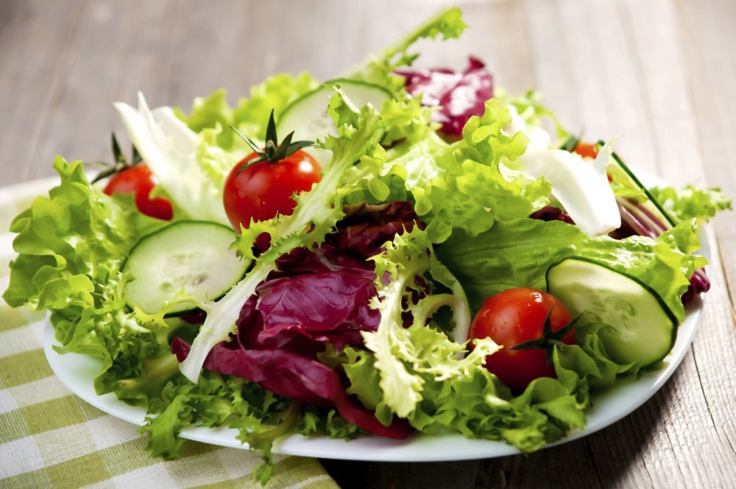
Salads
Cucumbers, tomatoes, onions, cabbage, peppers, beets and nettles are served for salad dishes ...

Slide 20
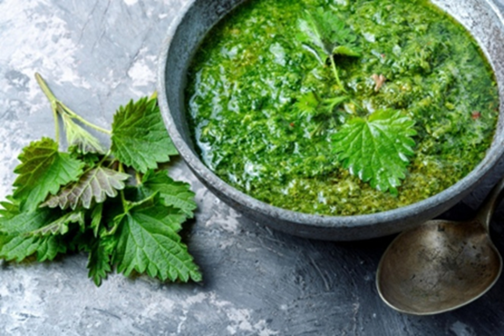
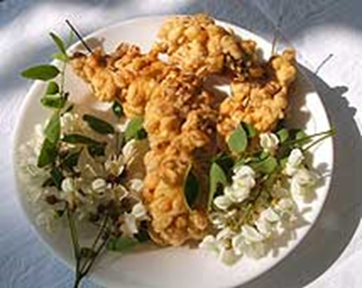
Spring nettles and young accacia flowers are prepared like spinach.
Elderflowers and accacia flowers can be used for salads, but they can also be made into juices and cordials.

Slide 21
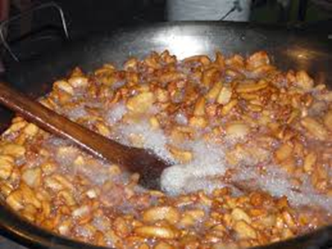
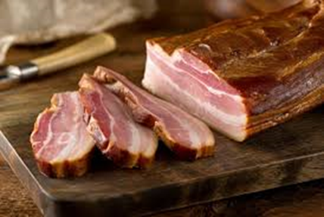
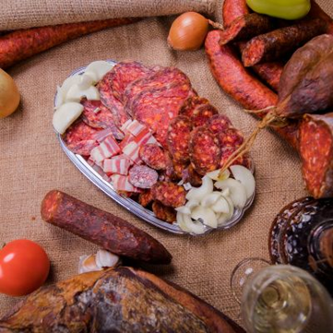
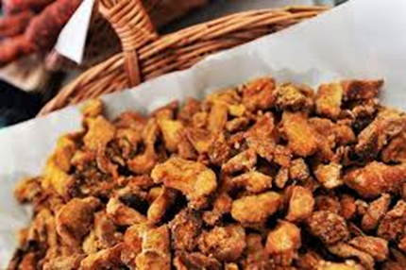
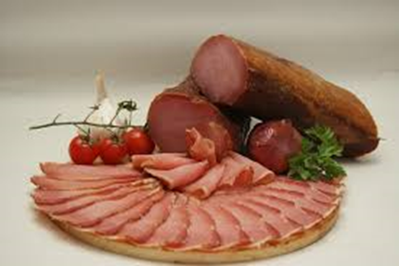
Smoked meat, dairy and pork greaves are a favourite of the residents of Podravina

Slide 22
In Podravina, numerous events are connected with local food:
‘’Picokijada’’, Honey Days, ‘’Prkačijada’’,’’ Mudlinijada’’, Fishermen to their town ...

Slide 23
‘’Štrukelj’’ ( strudel) is probably one of the most widespread cakes in the Podravina region. In Đurđevac it is called štrukel, and in Virje strudel. It is made with ground nuts, dairy and fruit fillings.
‘’Mlinec’’ is a quantitative measure of dough that is taken when baking cakes and is formed when approximately 1/4 kg of flour is kneaded.
Housewives (in Podravina, the common name of the landlady or ‘’sokačica’’) have a custom of measuring the amount of flour as follows:
1 household baking pan (1 tray,’’protvan’’ in the Koprivnica region) contains of 4-6 long rolls of the strudel, which are made with a kilo of flour. Podravina štruklji are filled with cheese, apples, poppies, walnuts, cherries, sour cherries, cabbage, but also with browned flower, carob and porridge (millet or buckwheat porridge).
‘’Zafrig’’, or ‘’zaprska’’ ( browned flour) is used in Podravina in the preparation of many types of dishes, and in ancient times it was also used as a filling in cakes (Dolenec Dravski 1993/94: 229-230).
For ‘’štruklji’’, the name ‘’gibanica’’ is also known. Podravina's specialty is buckwheat strudel or millet porridge strudel, sprayed with pumpkin seed oil, and they are called ‘’kašnjaki’’ or fasting strudels because they are often baked during Advent and Lent.

Slide 24
Thank You
Insert the Sub Title of
Your Presentation

